Slide 1
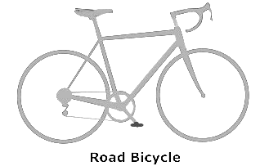
R
θ

Slide 2
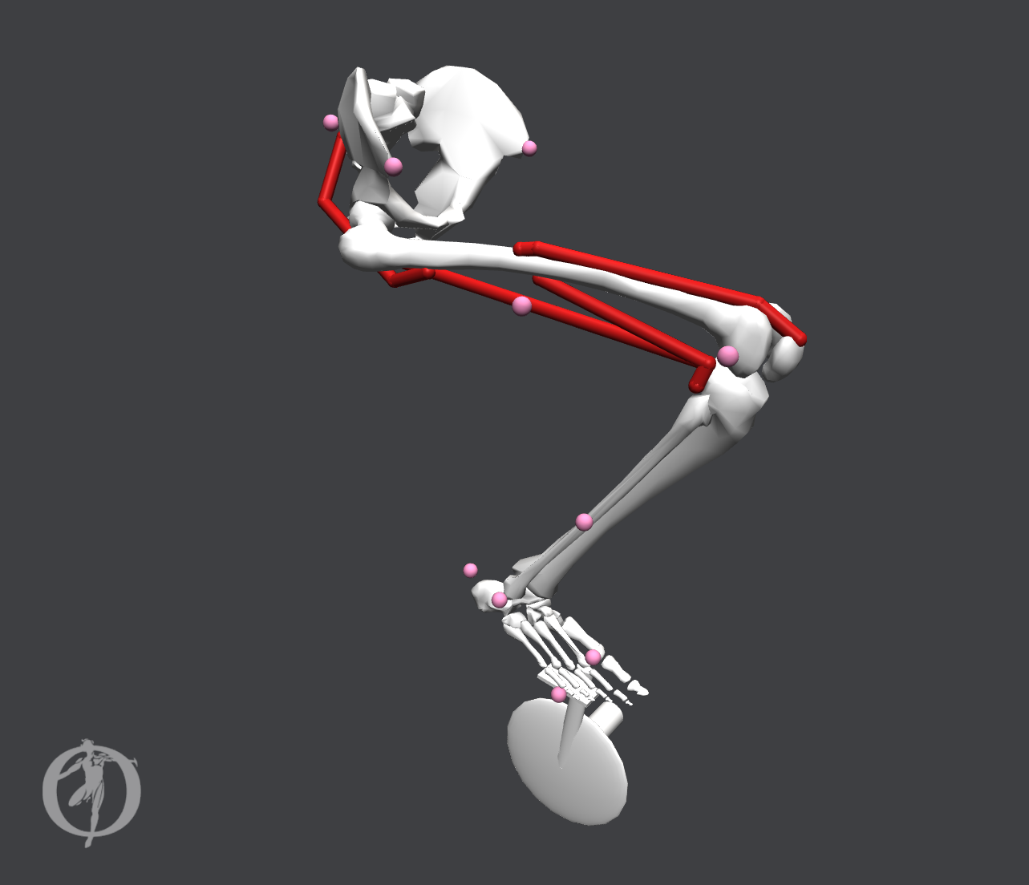
Vastus Intermedius
Gluteus Maximus
Biceps Femoris
Long Head (LH)
Biceps Femoris
Short Head (SH)

Slide 3
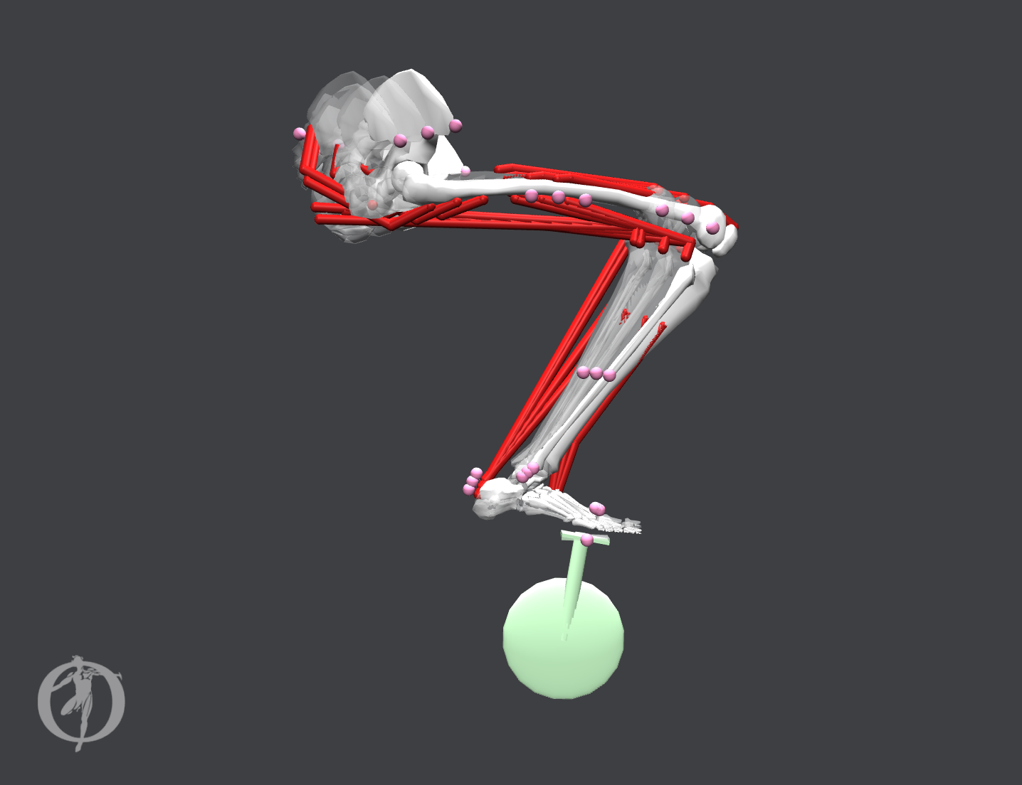
ΔR
R
θ
Δθ
Y
X
Notes:
Figure Methods 1

Slide 4
R
θ
Y
X
Notes:
Figure Methods 1

Slide 5
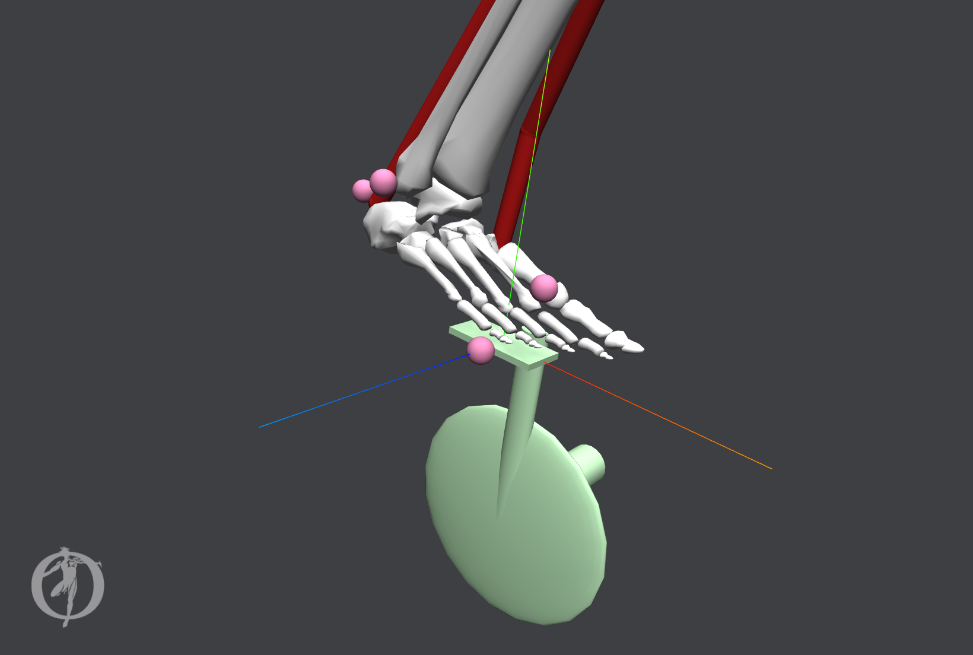
Y
φ
Z
X

Slide 6
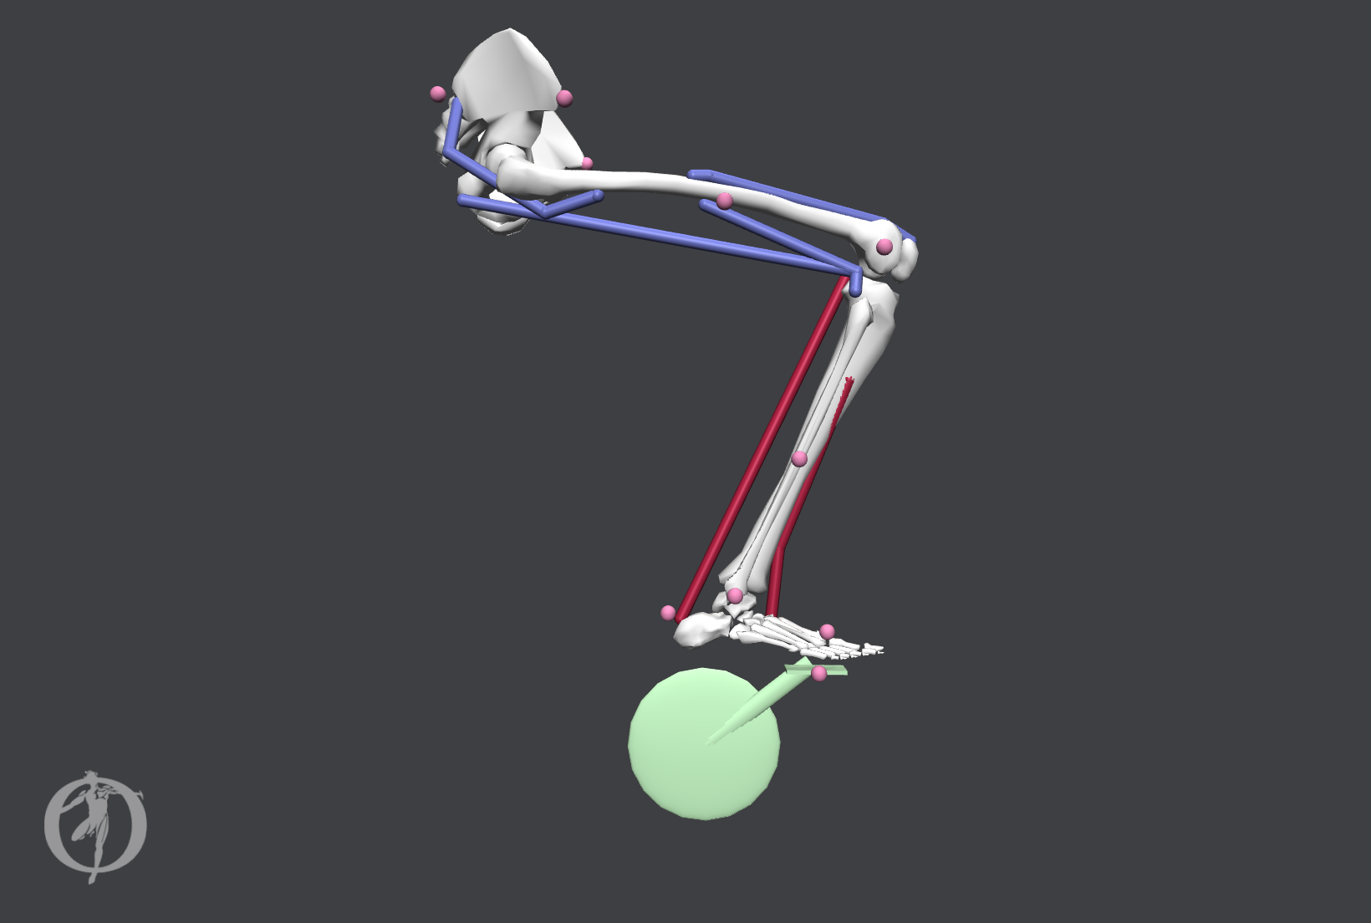
ω_{crank} = 80 rpm
T _{prescribed function}

Slide 7
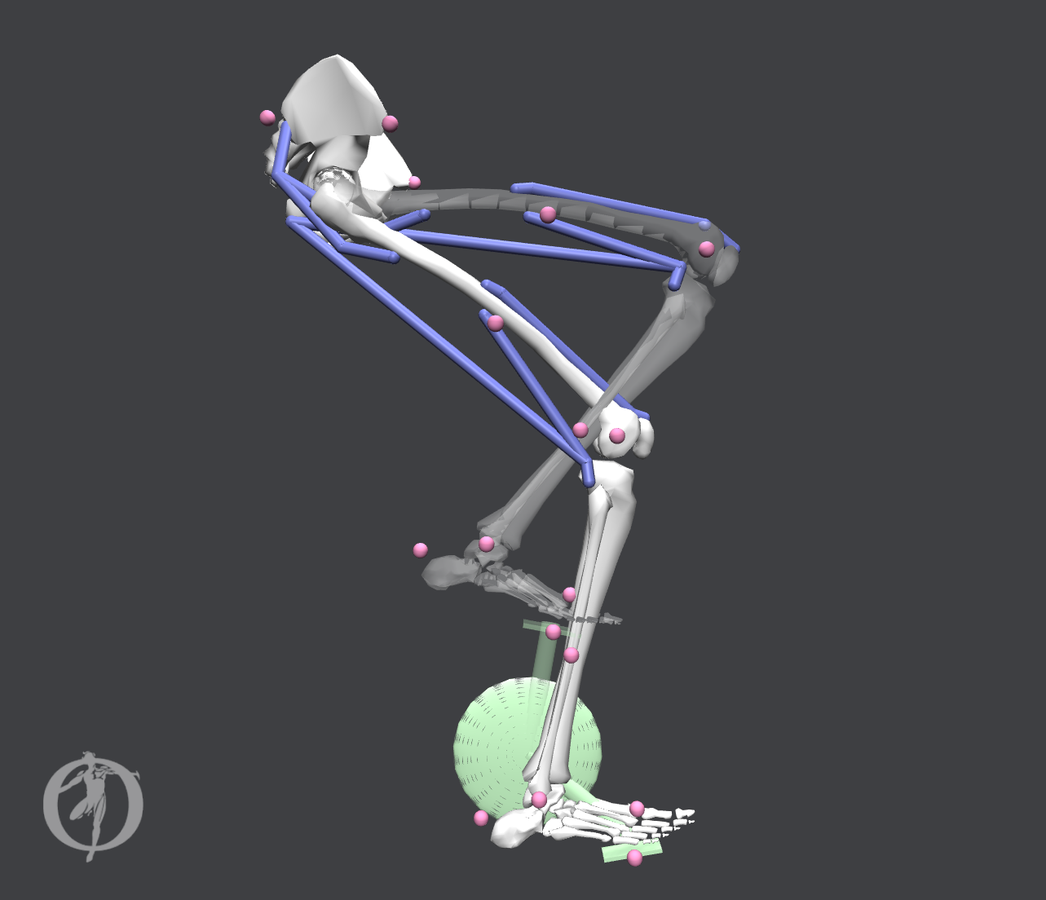
l_{fiber length}(t)
q_{joint angle}(t)
ω_{crank} = 80 RPM

Slide 8
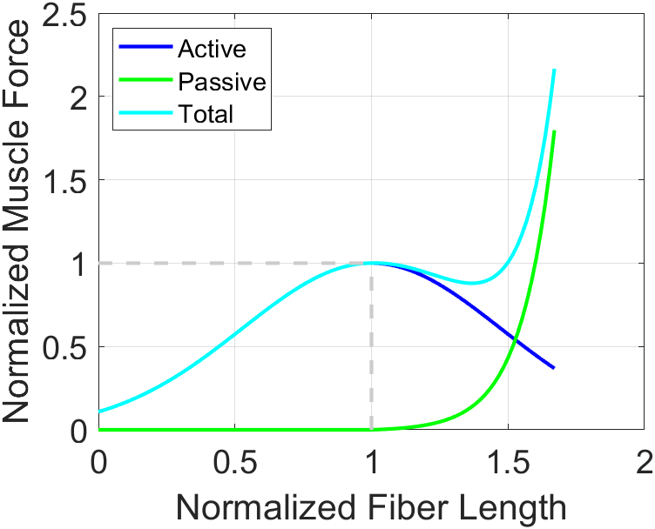

Slide 9
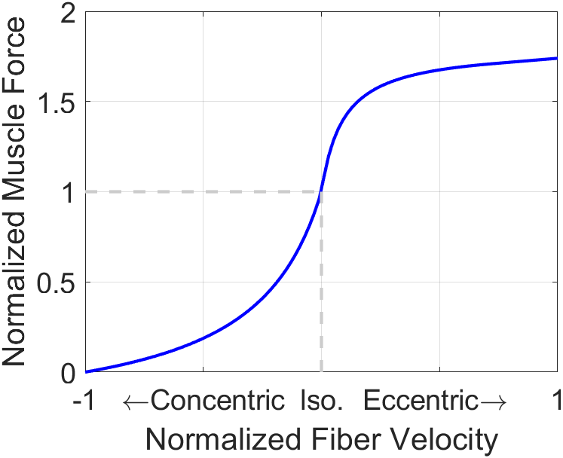

Slide 10
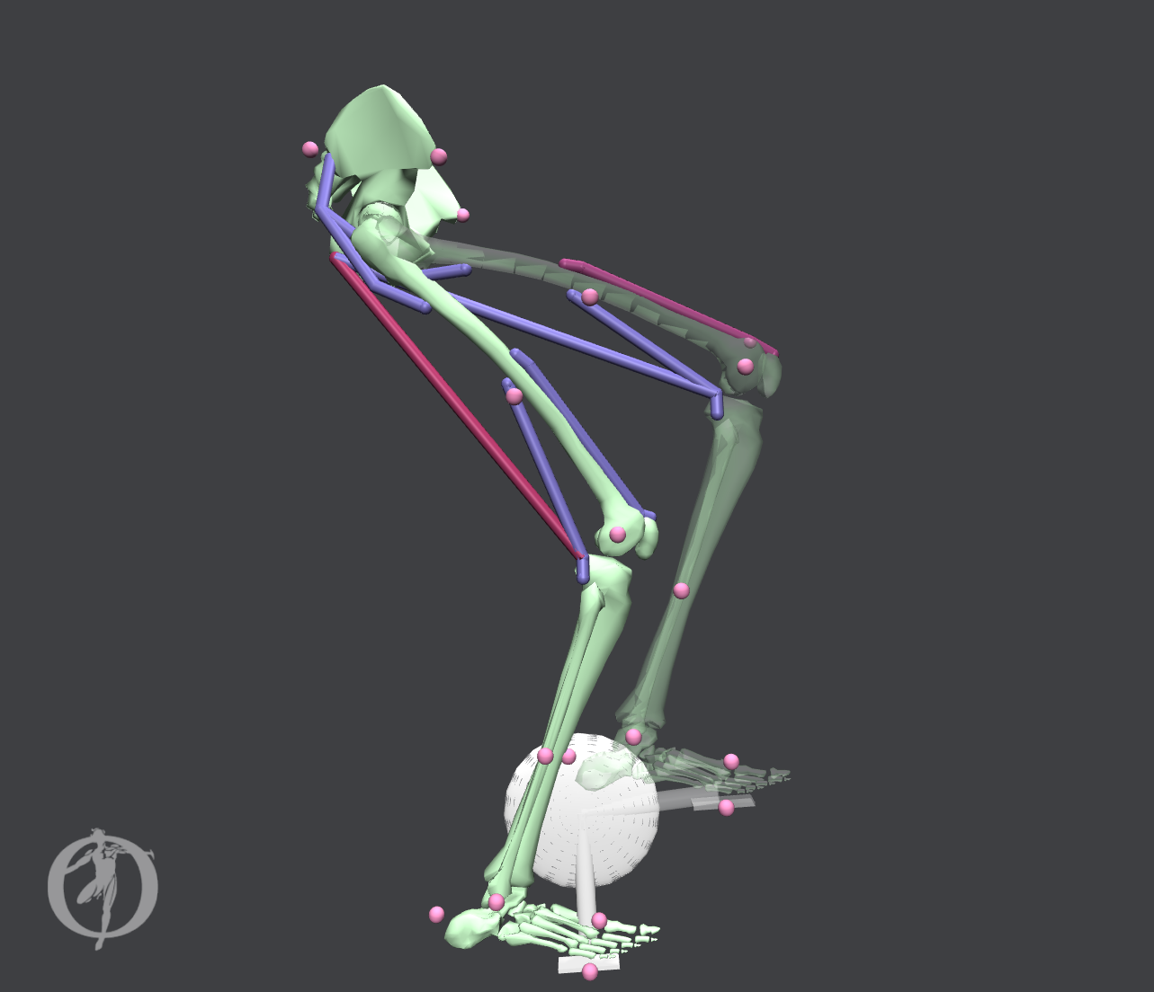

a_{vas_int}
a_{bifemlh}
a_{muscle} ∈ [0, 1]

Slide 11
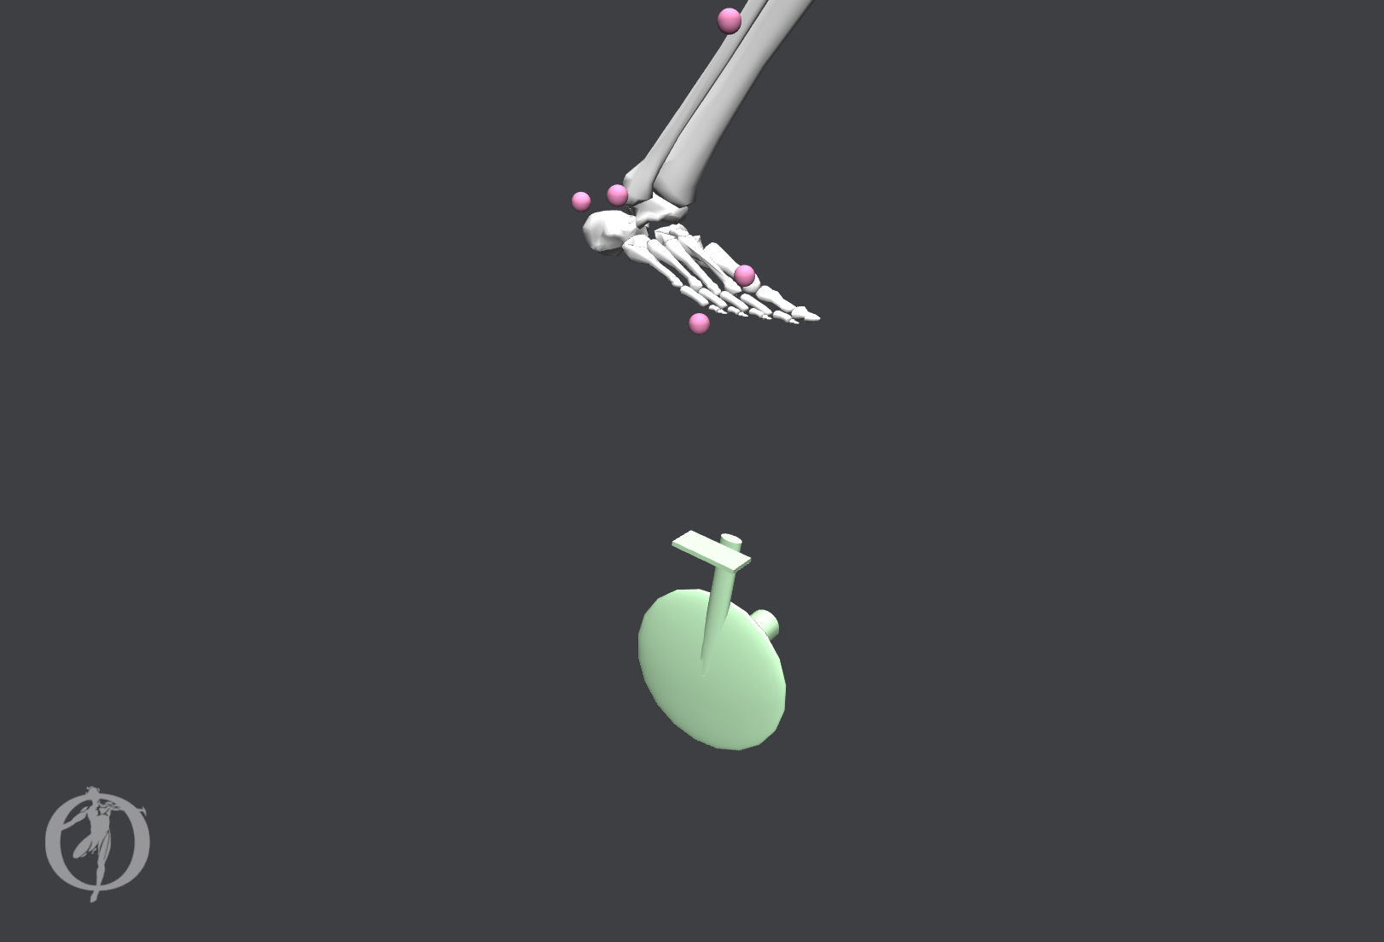
T _{pedal-on-foot}
F _{pedal-on-foot}
F _{foot-on-pedal}
T _{foot-on-pedal}

Slide 12
J = Σw_{i} x_{i}² + Σw_{j} ( q’’_{j, des} - q’’_{j, CMC} )²

Slide 13
F^{M}(t) = F_{o}^{M}[a(t) f ^{L}(ℓ ^{M}(t)) f ^{V}(𝑣^{M}(t)) + f ^{PE}(ℓ ^{M}(t))]

Slide 14
A = Σ(w_{i} (q_{i} - q_{des, i} )²)
A subject to constraint equations: G(q)-G₀ = 0

Slide 15
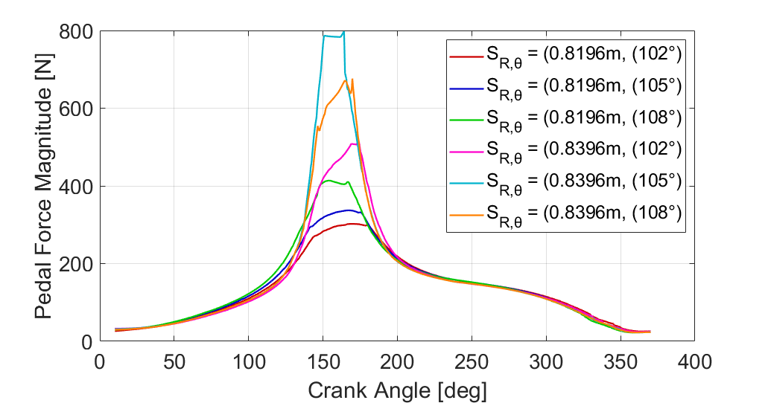

Slide 16
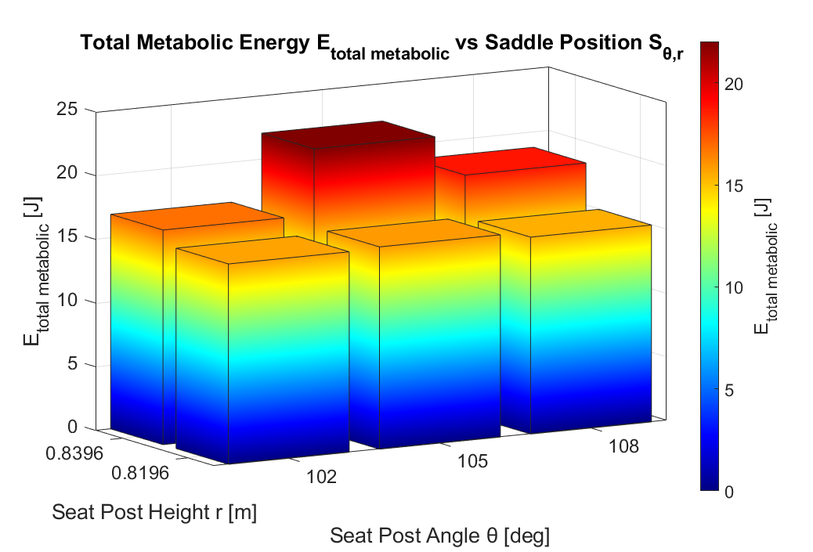
Notes:
This is what we see when we numerically integrate the metabolic energy expenditure over the entire simulation time for all 6 trials

Slide 17
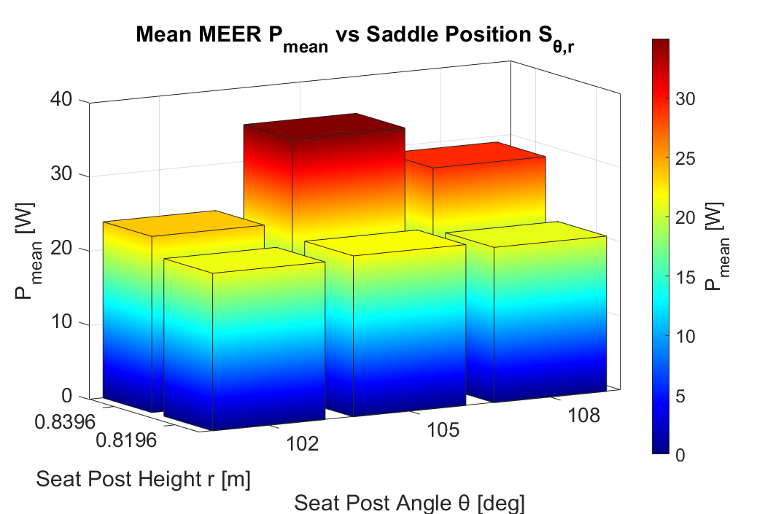
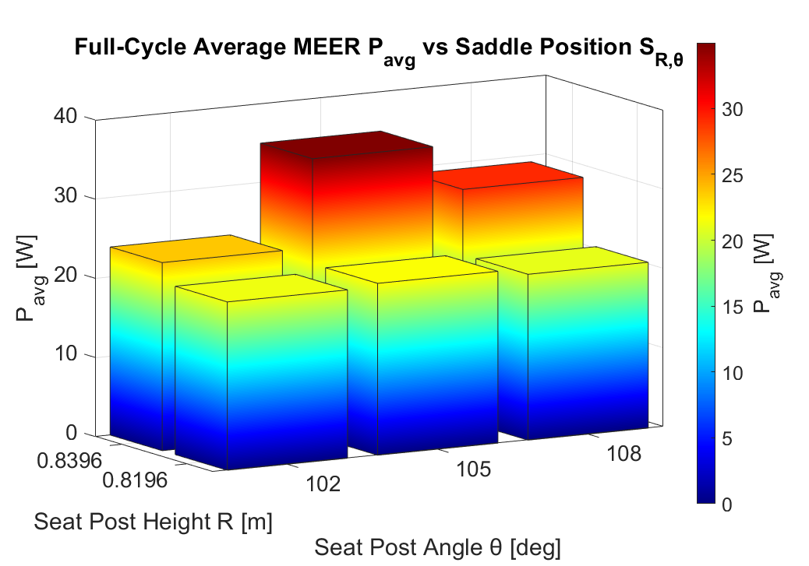
Notes:
This is what we see when we simply average the total metabolics over the simulation time for all 6 trials

Slide 18
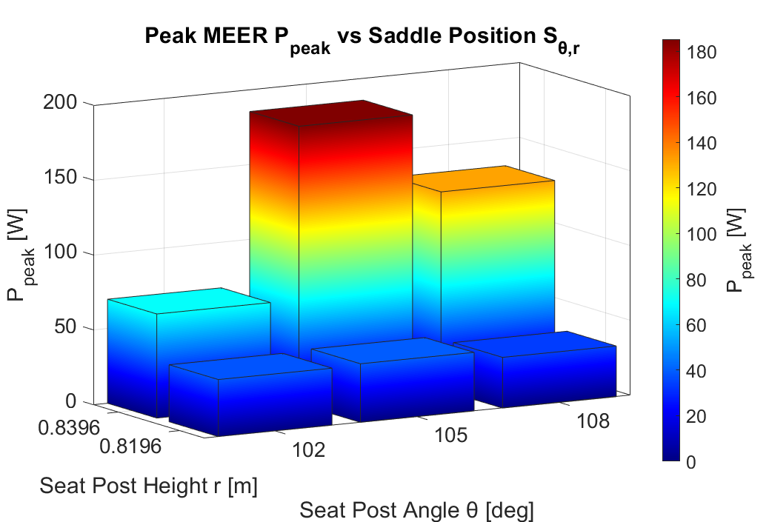
Notes:
This is what we see when we extract the maximum of the total metabolics over the simulation time for all 6 trials

Slide 19
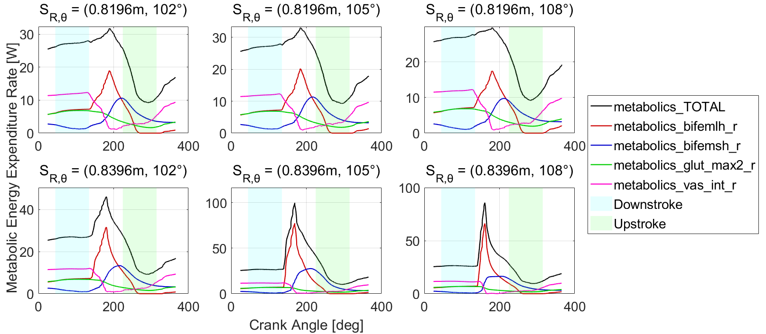
Notes:
MEER for all 6 trials

Slide 20
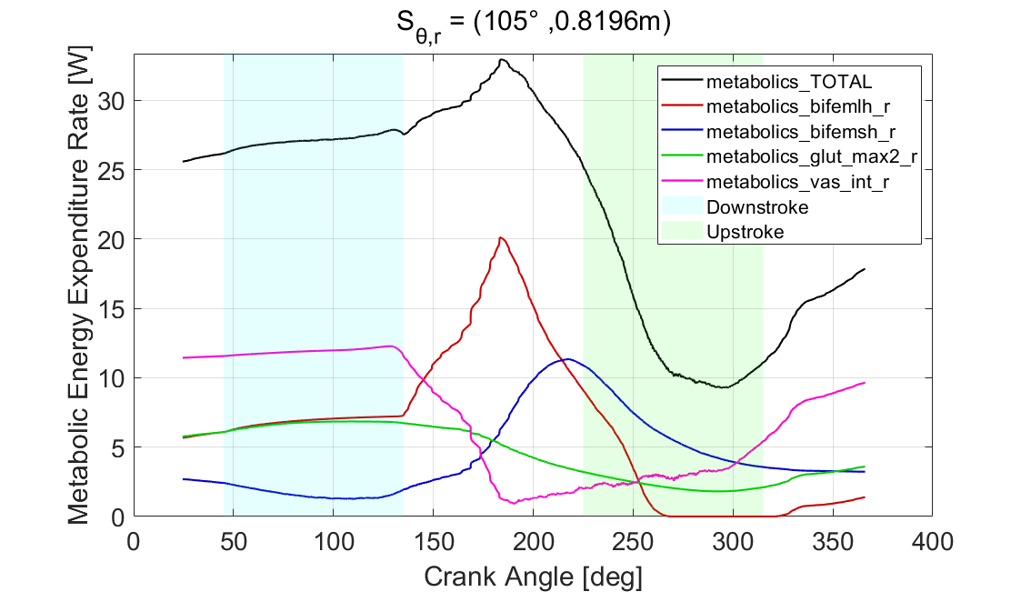
Notes:
MEER for θ = 105° and R = 0.8196 m

Slide 21
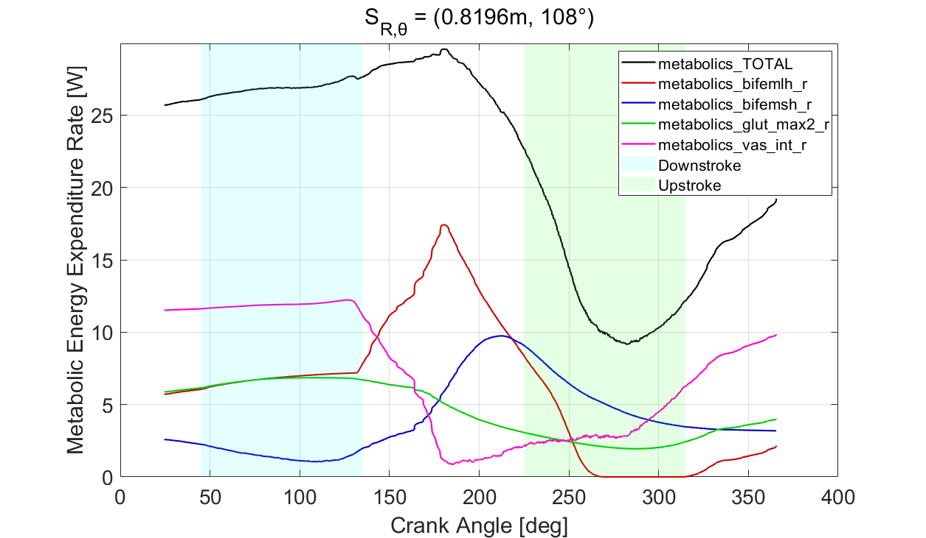
Notes:
MEER for θ = 105° and R = 0.8196 m

Slide 22
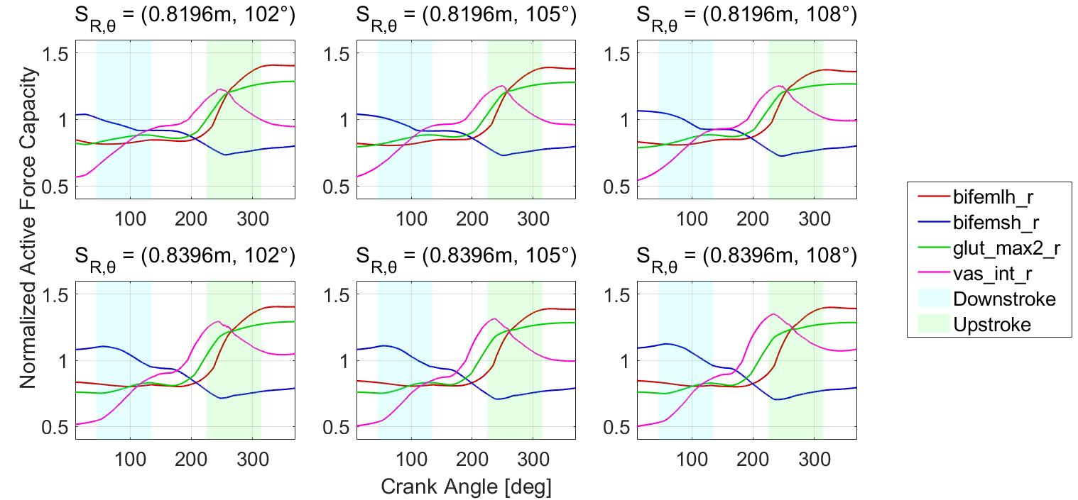
Notes:
Normalized active force capacity for all muscles for all 6 trials

Slide 23
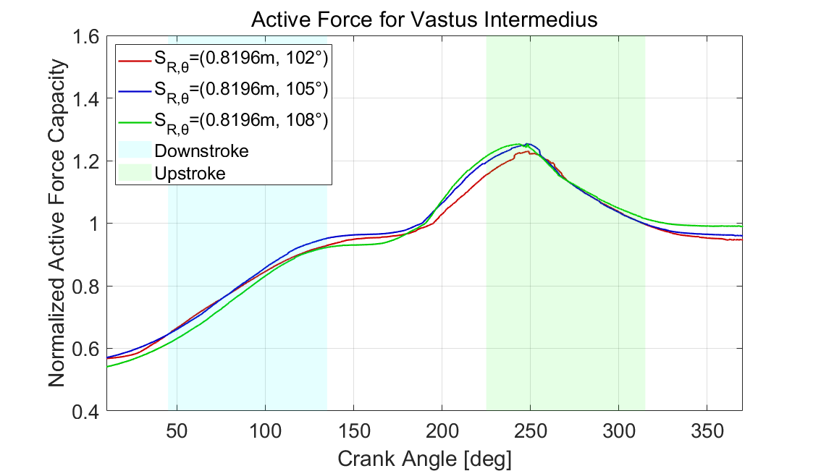
Notes:
Active force capacity for vastus intermedius for R = 0.8196 m

Slide 24
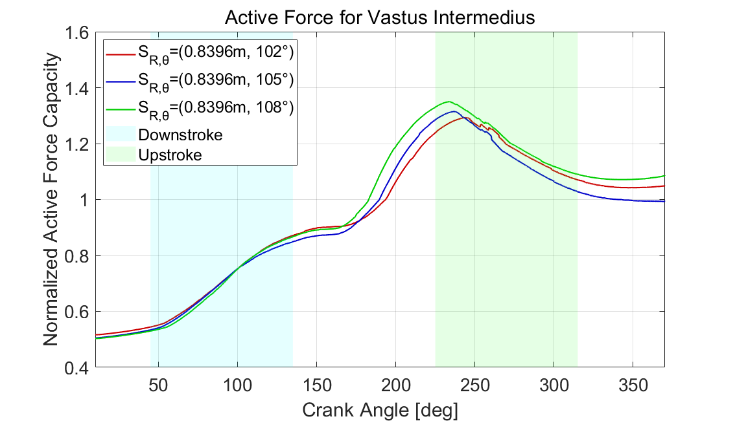
Notes:
Active force capacity for vastus intermedius for R = 0.8396 m

Slide 25
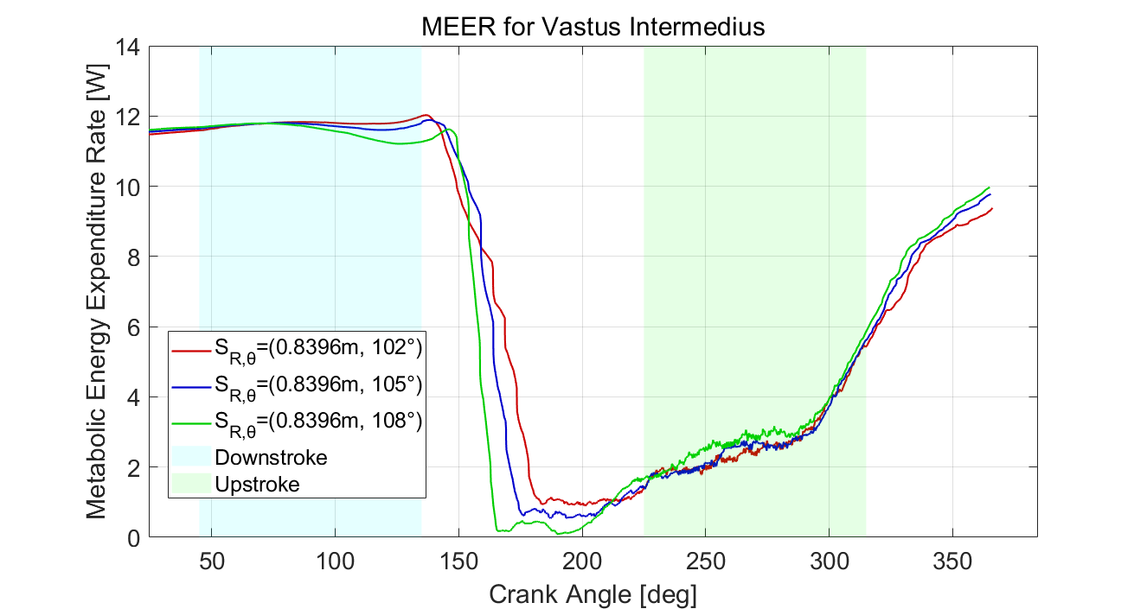
Notes:
Active force capacity for vastus intermedius for R = 0.8396 m

Slide 26
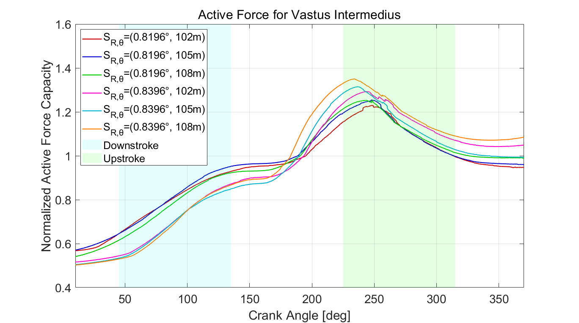
Notes:
Active force capacity for vastus intermedius for all 6 trials

Slide 27
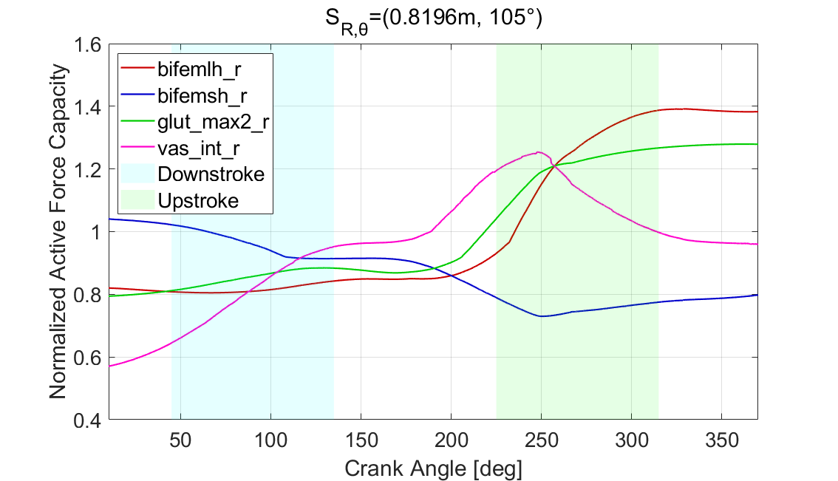
Notes:
Active force capacity for all muscles for single trial θ = 105°, R = 0.8196 m

Slide 28
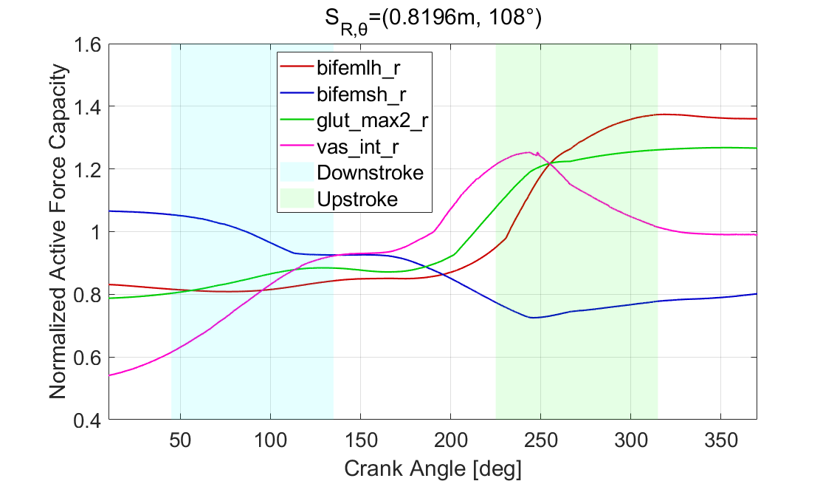
Notes:
Active force capacity for all muscles for single trial θ = 105°, R = 0.8196 m

Slide 29
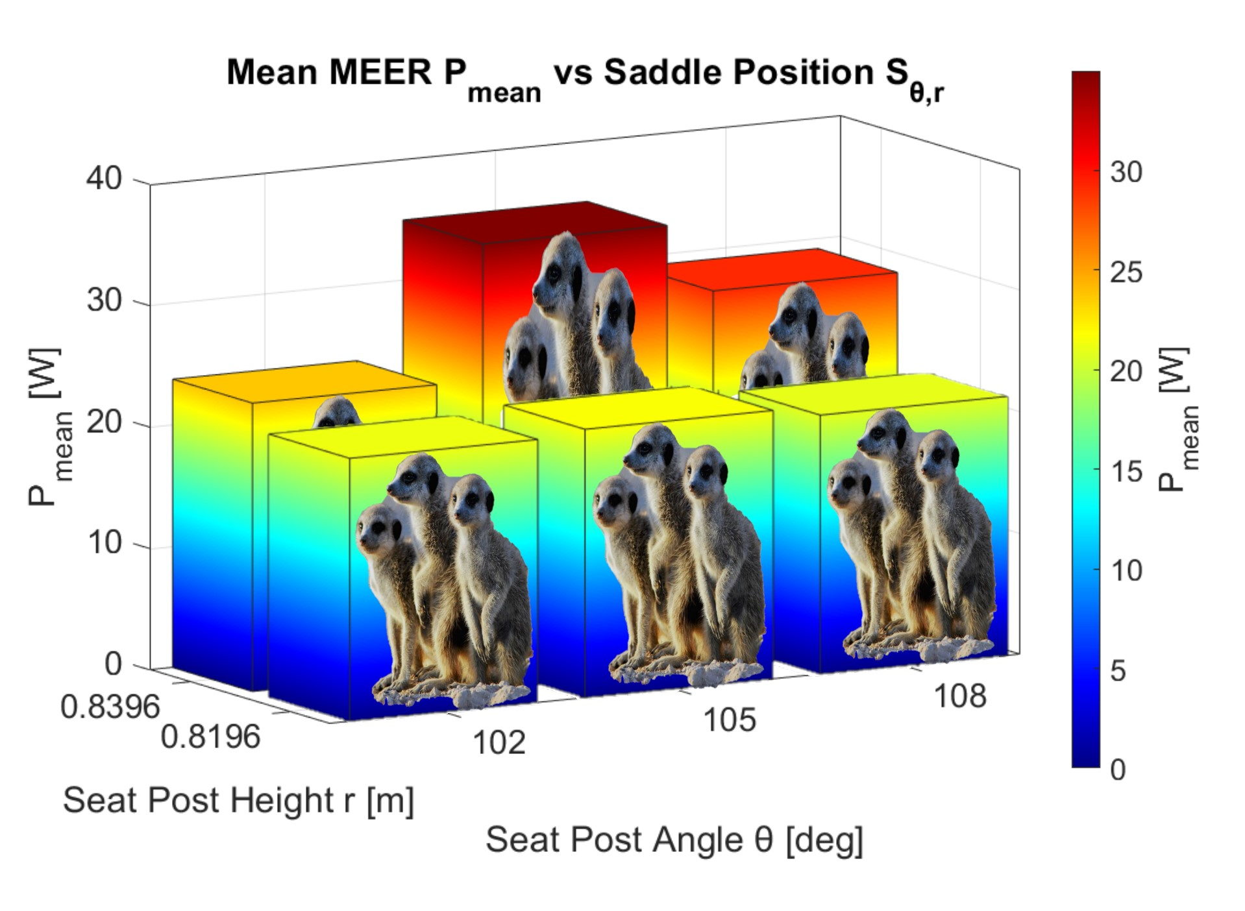
Notes:
p e r f e c t i o n

Slide 30
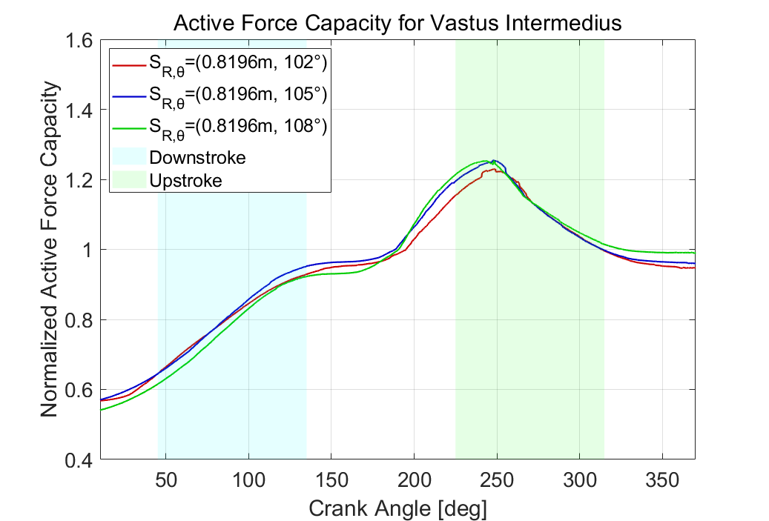

Slide 31
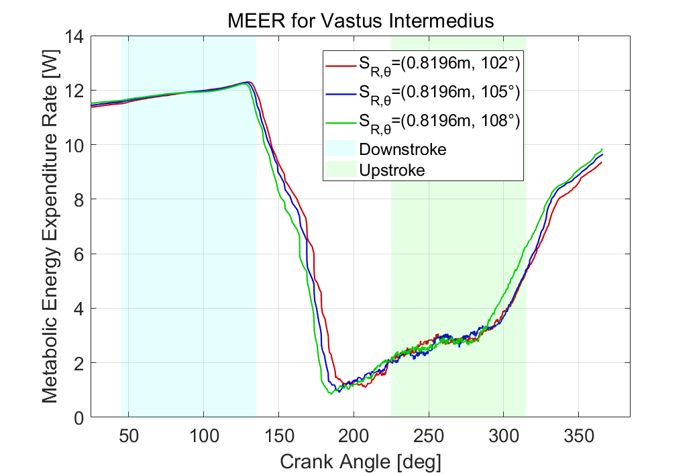

Slide 32
(Global) Ground Coordinate Frame
Y
Z
X

Slide 33
Crank Angle
DOF

Slide 34
Pelvis DOF

Slide 35
Hip DOF

Slide 36
Knee Angle
DOF

Slide 37
Ankle Angle
DOF

Slide 38
MTP Angle
DOF

